Slide 1

Help With Constructing a Family Tree (Pedigree)
Notes:
Click on page to activate graphics

Slide 2
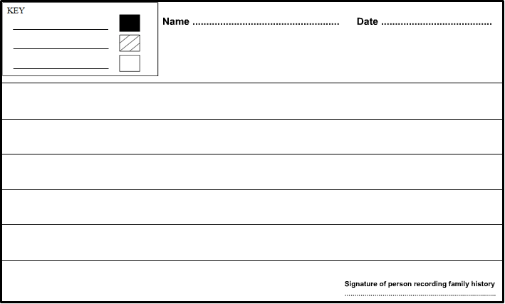
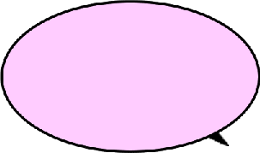

Here you will learn how to take a family history and construct a family tree using the symbols and relationship lines you learnt in the previous presentations.
Click on the next button to progress through the presentation.
Notes:
Click on page to activate graphics

Slide 3




Here you will learn how to take a family history and construct a family tree using the symbols and relationship lines you learnt in the previous presentations.
Click on the next button to progress through the presentation.
Notes:
Click on page to activate graphics

Slide 4
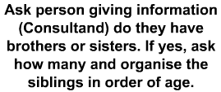


Here you will learn how to take a family history and construct a family tree using the symbols and relationship lines you learnt in the previous presentations.
Click on the next button to progress through the presentation.
Notes:
Click on page to activate graphics

Slide 5
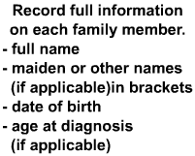






Here you will learn how to take a family history and construct a family tree using the symbols and relationship lines you learnt in the previous presentations.
Click on the next button to progress through the presentation.
Notes:
Click on page to activate graphics

Slide 6


Here you will learn how to take a family history and construct a family tree using the symbols and relationship lines you learnt in the previous presentations.
Click on the next button to progress through the presentation.
Notes:
Click on page to activate graphics

Slide 7

Here you will learn how to take a family history and construct a family tree using the symbols and relationship lines you learnt in the previous presentations.
Click on the next button to progress through the presentation.
Notes:
Click on page to activate graphics

Slide 8

Here you will learn how to take a family history and construct a family tree using the symbols and relationship lines you learnt in the previous presentations.
Click on the next button to progress through the presentation.

Slide 9

Here you will learn how to take a family history and construct a family tree using the symbols and relationship lines you learnt in the previous presentations.
Click on the next button to progress through the presentation.

Slide 10

Here you will learn how to take a family history and construct a family tree using the symbols and relationship lines you learnt in the previous presentations.
Click on the next button to progress through the presentation.

Slide 11
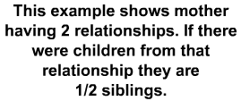
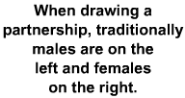
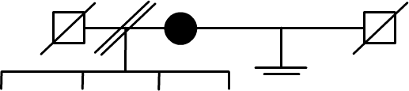
Here you will learn how to take a family history and construct a family tree using the symbols and relationship lines you learnt in the previous presentations.
Click on the next button to progress through the presentation.

Slide 12

Here you will learn how to take a family history and construct a family tree using the symbols and relationship lines you learnt in the previous presentations.
Click on the next button to progress through the presentation.
Notes:
Click on page to activate graphics

Slide 13

Here you will learn how to take a family history and construct a family tree using the symbols and relationship lines you learnt in the previous presentations.
Click on the next button to progress through the presentation.

Slide 14

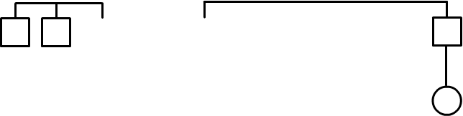
Here you will learn how to take a family history and construct a family tree using the symbols and relationship lines you learnt in the previous presentations.
Click on the next button to progress through the presentation.
Notes:
Click on page to activate graphics

Slide 15

Here you will learn how to take a family history and construct a family tree using the symbols and relationship lines you learnt in the previous presentations.
Click on the next button to progress through the presentation.

Slide 16

Here you will learn how to take a family history and construct a family tree using the symbols and relationship lines you learnt in the previous presentations.
Click on the next button to progress through the presentation.
Notes:
Click on page to activate graphics

Slide 17

Here you will learn how to take a family history and construct a family tree using the symbols and relationship lines you learnt in the previous presentations.
Click on the next button to progress through the presentation.

Slide 18

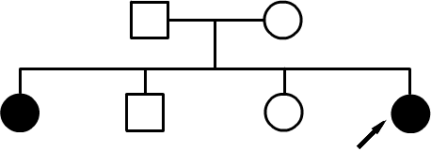
Here you will learn how to take a family history and construct a family tree using the symbols and relationship lines you learnt in the previous presentations.
Click on the next button to progress through the presentation.

Slide 19

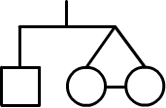
Here you will learn how to take a family history and construct a family tree using the symbols and relationship lines you learnt in the previous presentations.
Click on the next button to progress through the presentation.
Notes:
Click on page to activate graphics

Slide 20
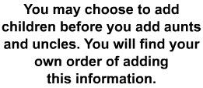
Here you will learn how to take a family history and construct a family tree using the symbols and relationship lines you learnt in the previous presentations.
Click on the next button to progress through the presentation.

Slide 21
Here you will learn how to take a family history and construct a family tree using the symbols and relationship lines you learnt in the previous presentations.
Click on the next button to progress through the presentation.
Notes:
Click on page to activate graphics

Slide 22

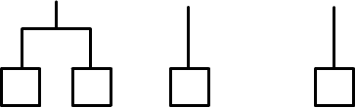
Here you will learn how to take a family history and construct a family tree using the symbols and relationship lines you learnt in the previous presentations.
Click on the next button to progress through the presentation.
Notes:
Click on page to activate graphics

Slide 23

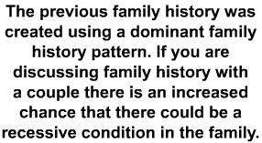
Here you will learn how to take a family history and construct a family tree using the symbols and relationship lines you learnt in the previous presentations.
Click on the next button to progress through the presentation.

Slide 24
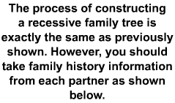
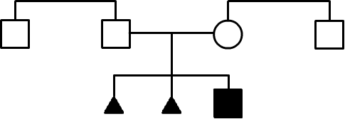
Here you will learn how to take a family history and construct a family tree using the symbols and relationship lines you learnt in the previous presentations.
Click on the next button to progress through the presentation.

Slide 25

Here you will learn how to take a family history and construct a family tree using the symbols and relationship lines you learnt in the previous presentations.
Click on the next button to progress through the presentation.

